Slide 1
The Benefits of a Catholic Education at St. Joseph School
St. Joseph Guild Hall
March 11, 2019

Slide 2
Our Mission:
The Mission of St. Joseph School is to provide the highest quality of spiritual and academic education in order to meet life’s challenges by developing integrity, respectfulness, and resourcefulness in a faith filled environment.

Slide 3
What does an investment in St. Joseph School do for your child?

Slide 4
Our Comprehensive Program: PK-8
Archdiocese of Hartford Curriculum is internationally recognized and used.
AOH Standards align with national standards and exceed the Common Core State Standards.
Catholic Schools in AOH provide a comprehensive program from 3 years old through senior year of high school.

Slide 5
St. Joseph School Academic Data:
IOWA Assessments: nationally standardized assessment used by schools to assess instruction.
The longer students remain at SJS, the higher the increase (on average) in Grade Equivalency.
SJS students score, on average, above grade level each year.
Grade | Grade Equivalent Score for Class Avg. (Complete Composite 2017-2018) | Difference
3 | 4.7 | +1.7
4 | 5.9 | +1.9
5 | 7.1 | +2.1
6 | 8.3 | +2.3
7 | 11.2 | +4.2

Slide 6
Stand out areas for our SJS classes from 2017-2018:
SJS 7th Graders (last year of assessment): Class average Grade Equivalent per subject area
Reading = 9.6 (freshman year of HS)
Written Expression = 13 + (college level)
Vocabulary = 9.8 (end of freshman year HS)
Mathematics = 11 (junior year of HS)
Social Studies = 11.1 (junior year of HS)
Science = 12 (senior year of HS)
National Percentile Rank:
All grades (3-8) fall in the 73rd percentile or higher for ELA
All grades (3-8) fall in the 64th percentile or higher for Math

Slide 7
How to look at IOWA Assessment data:
Testing Subject Area is at the top (ex: Reading)
Top right indicates which Class
“Bulding % C” is the percent correct for the specific SJS class.
“Sys. % C” is the percent correct for the Archdiocese of Hartford.
“Nat. % C” is the percent correct for the Nation.
“Class/Nation Difference” is the difference between how SJS students scored compared the rest of the Nation.
Note the areas (and frequency) that SJS students score “+20” above the Nation.

Slide 8
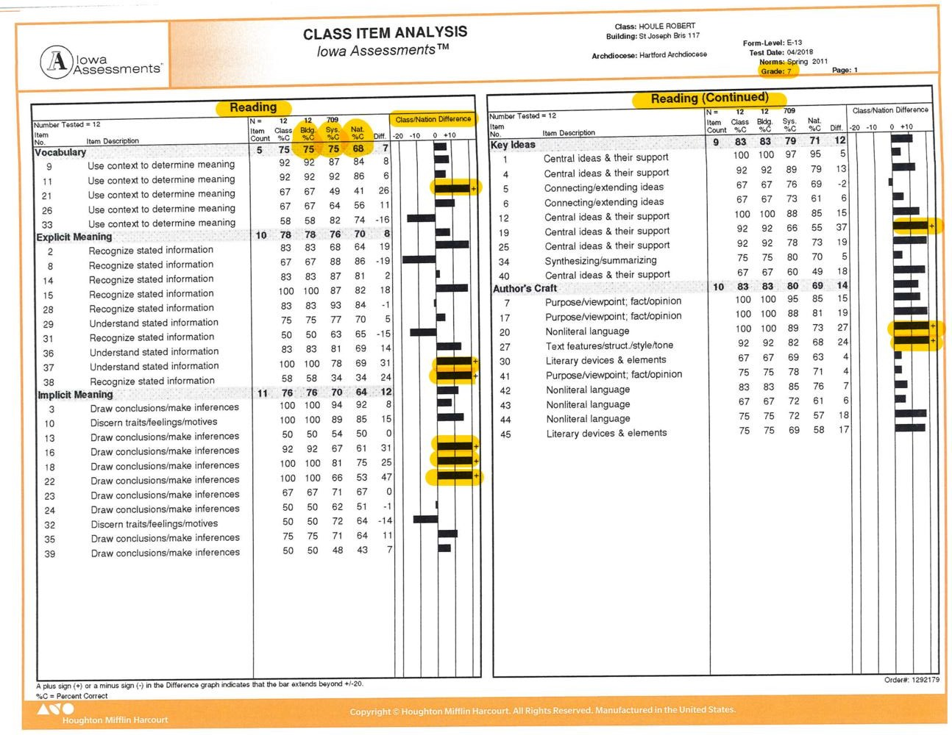

Slide 9
Last year’s 8th Grade Exit Survey Feedback:
70% felt St. Joseph School was Very Effective in preparing them academically for high school.
80% felt St. Joseph School was Very Effective in preparing them to be respectful.
60% felt their Middle School experience was GREAT, 40% felt it was GOOD.
94% identified SJS Curriculum as a strength of the school. 80% identified faculty and staff as a strength. 80% identified Athletics as a strength.

Slide 10
Last year’s Family Survey Results:
90% of families* agree St. Joseph School is a great school.
80% of families feel their children are safe at St. Joseph School.
85% of families identify Faculty and Staff as a strength of SJS.
95% of families feel that their children are receiving a quality religious and spiritual education.
*of families who completed the survey

Slide 11
Guest Speakers for Tonight:
Mr. Cary Dupont: President of St. Paul Catholic High School
Elizabeth Ruffino: SJS alum (Class of 2018), currently student at Bristol Central
Carter Dossias: SJS alulm (Class of 2018), currently student at St. Paul Catholic High School
Mr. Dossias: father of Carter and Paige Dossias (both graduates from SJS)
Mrs. Wilson: current parent of four SJS students (8th grade, 4th grade, and Pre-K)
Mrs. Milio: current parent of SJS kindergarten student
Ms. Ashley Kowsikowski: SJS alum (Class of 2010), graduate of St. Paul Catholic High School (Class of 2014) and recent graduate of St. Anselm College (2018)

